Slide 1




FinQuest
USER MANUAL
BY:-
ZAINAB SAEED

Slide 2



CONTENTS
01
ABOUT ME TAKING TEST
05
02
MY INTERSHIP JOURNEY PREVIEW
06
03
ABOUT “FinQuest” TIPS
07
TOOLKIT WALKTHROUGH
04
STEPS TO SATRT THE
APP
08

Slide 3

Acknowledgement
I would like to show my sincere gratitude to my parengts especially my mom who kept motivating me to take and complete this internship program. She got connected to the clevered team and helped me get into this course, Also, this journey had been great as I got good support from my mentor, Ms Sanjana Ma’am. She was always ready to help me solve my difficulties,doubts and questions.
Also, I would like to thank Ms. Sona ma’am who has always supported me and managed my schedule despite of my busy schedule.

Slide 4
ABOUT ME
Zainab Saeed
18yrs old
currently pursuing my bachalor’s degree in commerce field
FY at Symbiosis College of Arts and Commerce,Pune

Slide 5
My Internship Journey
NEW CODES
UNDERSTANDING HOW AI WORKS
FUN
learn
Grow
DIFFERENT FUNCTIONS
INBUILT LIBRARIES

Slide 6

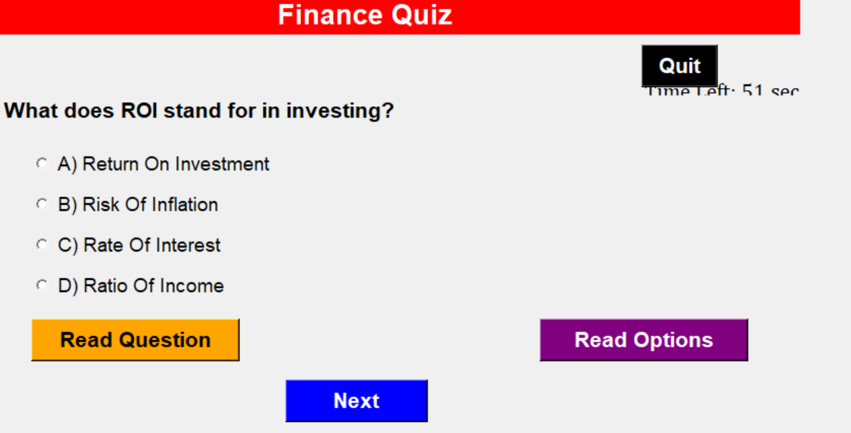
About My App:
FinQuest Application is an interactive tool designed to test and improve your knowledge of finance. It offers quizzes with varying difficulty levels and provides immediate feedback on your performance.

Slide 7


STEPS TO START THE TEST:
STEP 1:
Launching the Application:
Run the application to open the main window.
STEP 2:
Main Screen:
The main screen displays the title “FinQuest" at the top.
.

Slide 8
STEPS TO START THE TEST:
STEP 3:
Beginning the Quiz:
After selecting the difficulty, click the "Start Quiz" button.
STEP 4:
Quiz Completion:
The quiz ends when all questions are answered or time runs out.

Slide 9


While Taking the FinQuest Test:
Question Display:
Each question is displayed in the center of the window.
2. Answering Questions:
Four multiple-choice options are provided for each question.
Select your answer by clicking on the appropriate radio button.
3. Navigation:
Click the "Next" button to submit your answer and move to the next question.
You must select an answer before proceeding to the next question.
4. Time Limit:
Each quiz has a 60-second time limit.
The remaining time is displayed in the top-right corner.
5. Audio Features:
"Read Question" button: Click to hear the question read aloud.
"Read Options" button: Click to hear all answer options read aloud.
6. Feedback:
After each question, you'll receive immediate feedback.

Slide 10

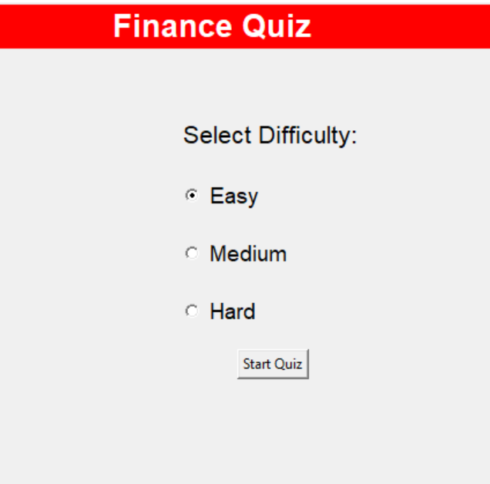
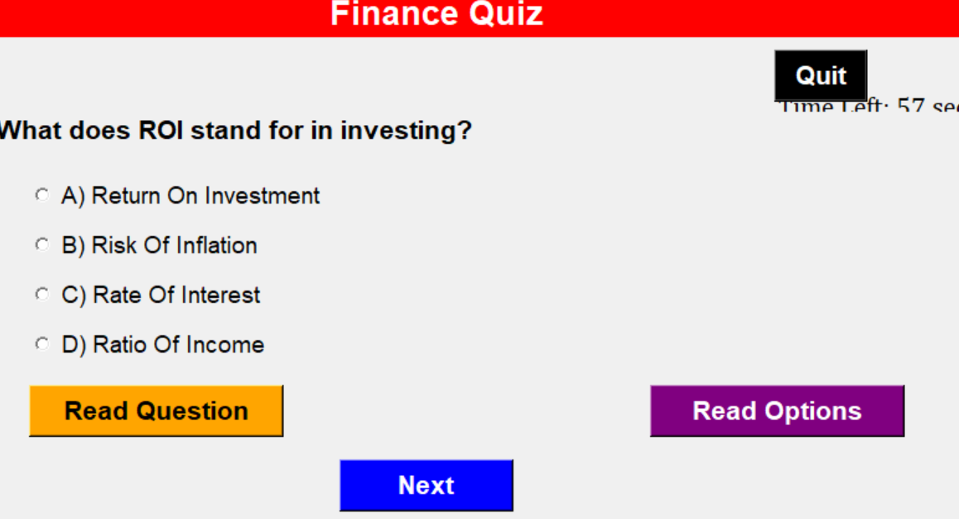
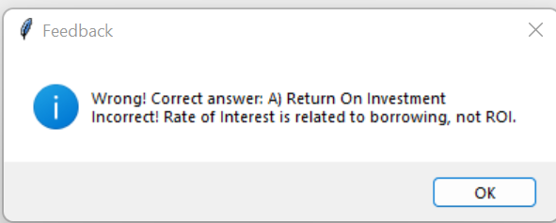
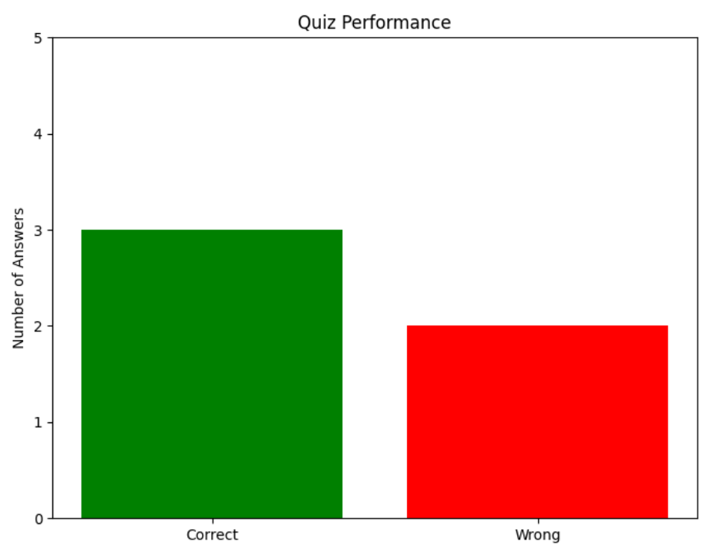
A PREVIEW
OF THE APP
AND ITS
FEATURES
FinQuest
FinQuest

Slide 11


Tips for Success
Read each question carefully before selecting an answer.
Use the audio features if you prefer listening to reading.
Keep an eye on the timer to manage your time effectively.
Review the feedback after each question to learn from your mistakes.
FOR ANY FURTHER ASSISTANCE,
CONTACT @zainabtsaeed@gmail.com

Slide 12
TOOLKIT WALKTHROUGH:
Refer the AI App Development Toolkit Workbook –
"C:\Users\user\Documents\CLEVERED\AI-App Development Toolkit Workbook.xlsx"

Slide 13

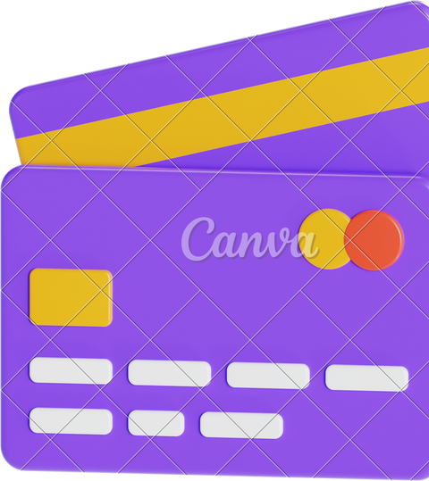


CONCLUSION
The FinQuest Application enhances financial knowledge and decision-making skills:
• Adaptive difficulty levels cater to all learning stages • Real-time feedback and explanations reinforce learning • Timed quizzes simulate real-world decision-making pressure • Visual performance analysis tracks progress over time • Improves personal financial management and professional competence • Builds confidence in handling complex financial concepts • Encourages continuous learning for ongoing financial empowerment This format provides a quick overview of the app's key benefits and impact on personal and professional development.

Slide 14



THANK YOU!

